Slide 1
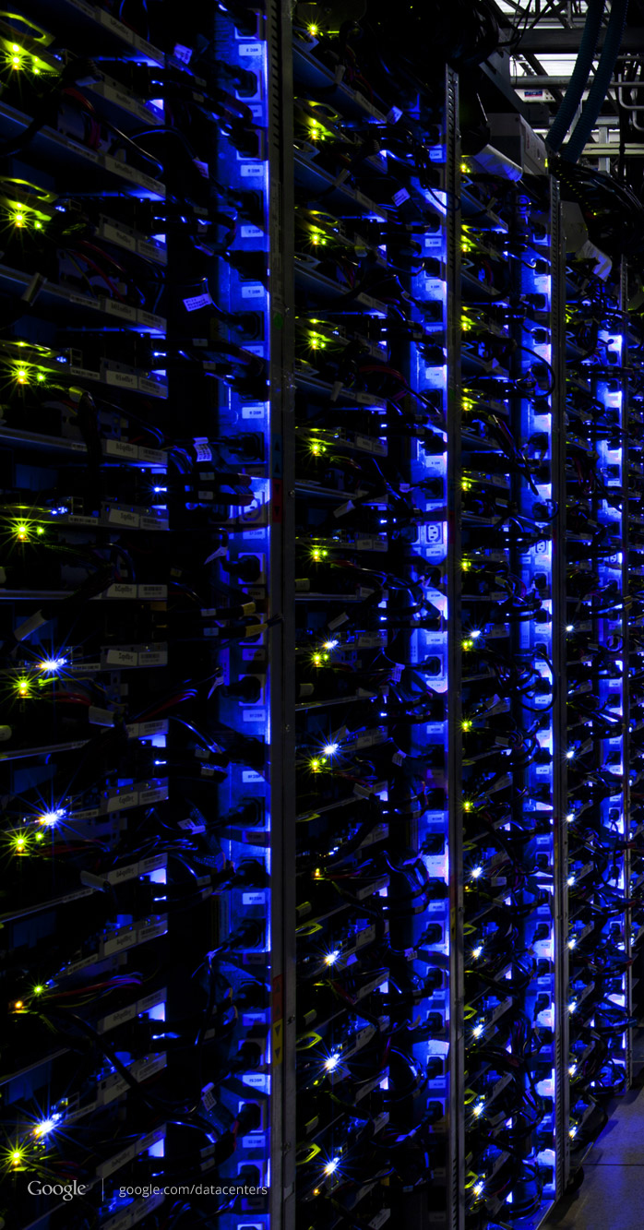
Software Defined Networking

Slide 2
SDN vs Traditional Network

Slide 3
Router 1
PC 2
PC 1
Router 3
Router 2

Slide 4
PC1
SDN Controller
PC2

Slide 5
Outline
What is SDN?
Background
An OS for networks
What is OpenFlow?
How it helps SDN
The current status and the future of SDN
Conclusions

Slide 6
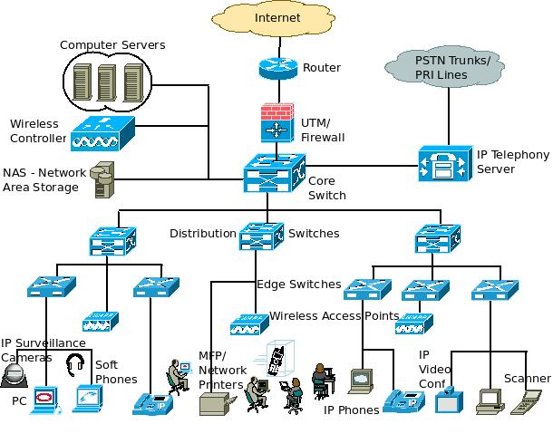
Limitations of Current Networks
Switches
http://www.excitingip.net/27/a-basic-enterprise-lan-network-architecture-block-diagram-and-components/

Slide 7
Limitations of Current Networks
Enterprise networks are difficult to manage
“New control requirements have arisen”:
Greater scale
Migration of VMS
How to easily configure huge networks?
Notes:
validate responsiveness as demand varies according to user needs
firewalls and load balancers
eliminate vulnerability and exposure between users and applications

Slide 8
















Limitations of Current Networks
Old ways to configure a network
App
App
App
Operating
System
Specialized Packet Forwarding Hardware
App
App
App
Operating
System
App
App
App
Specialized Packet Forwarding Hardware
Operating
System
App
App
App
Specialized Packet Forwarding Hardware
Operating
System
Specialized Packet Forwarding Hardware
App
App
App
Operating
System
Specialized Packet Forwarding Hardware
OpenFlow/SDN tutorial, Srini Seetharaman, Deutsche Telekom, Silicon Valley Innovation Center

Slide 9

Limitations of Current Networks
Feature
Feature
Many complex functions baked into infrastructure
OSPF, BGP, multicast, differentiated services, Traffic Engineering, NAT, firewalls, …
Million of lines of source code
Operating
System
Specialized Packet Forwarding Hardware
Billions of gates
Cannot dynamically change according to network conditions
OpenFlow/SDN tutorial, Srini Seetharaman, Deutsche Telekom, Silicon Valley Innovation Center

Slide 10
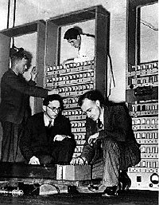
Limitations of Current Networks
No control plane abstraction for the whole network!
It’s like old times – when there was no OS…
Wilkes with the EDSAC, 1949
Notes:
Packages travel inside the network…
Switches pass them along…
But the decisions are made individually by the switches.. such as where to pass them
Nobody is dynamically controlling the network flow

Slide 11
Idea: An OS for Networks
Closed
App
App
App
Operating
System
Specialized Packet Forwarding Hardware
App
App
App
Operating
System
App
App
App
Specialized Packet Forwarding Hardware
Operating
System
App
App
App
Specialized Packet Forwarding Hardware
Operating
System
Specialized Packet Forwarding Hardware
App
App
App
Operating
System
Specialized Packet Forwarding Hardware
OpenFlow/SDN tutorial, Srini Seetharaman, Deutsche Telekom, Silicon Valley Innovation Center

Slide 12















Idea: An OS for Networks
Control Programs
Network Operating System
App
App
App
Operating
System
Specialized Packet Forwarding Hardware
App
App
App
Operating
System
App
App
App
Specialized Packet Forwarding Hardware
Operating
System
App
App
App
Specialized Packet Forwarding Hardware
Operating
System
Specialized Packet Forwarding Hardware
App
App
App
Operating
System
Specialized Packet Forwarding Hardware
OpenFlow/SDN tutorial, Srini Seetharaman, Deutsche Telekom, Silicon Valley Innovation Center
Notes:
How do we redefine the architecture to open up networking infrastructure and the industry!
By bring to the networking industry what we did to the computing world

Slide 13
Idea: An OS for Networks
Control Programs
Network Operating System
Simple Packet Forwarding Hardware
Simple Packet Forwarding Hardware
Simple Packet Forwarding Hardware
Simple Packet Forwarding Hardware
Simple Packet Forwarding Hardware
OpenFlow/SDN tutorial, Srini Seetharaman, Deutsche Telekom, Silicon Valley Innovation Center
Notes:
The key is to have a standardized control interface that speaks directly to hardware
A whole network is like a big machine

Slide 14
Idea: An OS for Networks
“NOX: Towards an Operating System for Networks”
Software-Defined Networking (SDN)
Control Programs
Global Network View
Network Operating System
Control via forwarding
interface
Protocols
Protocols
The Future of Networking, and the Past of Protocols, Scott Shenker, with Martin Casado, Teemu Koponen, Nick McKeown
Notes:
A remote controller has control of a switch’s forwarding decisions

Slide 15
Software Defined Networking
No longer designing distributed control protocols
Much easier to write, verify, maintain, …
An interface for programming
NOS serves as fundamental control block
With a global view of network
Notes:
The scope, the design goal
No need for distance-vector routing if you have a global view – compute dijkstra directly

Slide 16
Software Defined Networking
Examples
Ethane: network-wide access-control
Power Management
Notes:
Check network flow, scan…
Reduce the speed of the links that are not well utilized, or turn them off together

Slide 17
Software Defined Networking
Questions:
How to obtain global information?
What are the configurations?
How to implement?
How is the scalability?
How does it really work?

Slide 18
Outline
What is SDN?
Limitations of current networks
The idea of Network OS
What is OpenFlow?
How it helps SDN
The current status & the future of SDN
Conclusions

Slide 19
OpenFlow
“OpenFlow: Enabling Innovation in Campus Networks”
Like hardware drivers
– interface between switches and Network OS

Slide 20
OpenFlow
Control Path (Software)
Data Path (Hardware)
OpenFlow/SDN tutorial, Srini Seetharaman, Deutsche Telekom, Silicon Valley Innovation Center

Slide 21
OpenFlow
OpenFlow Controller
OpenFlow Protocol (SSL/TCP)
Control Path
OpenFlow
Data Path (Hardware)
OpenFlow/SDN tutorial, Srini Seetharaman, Deutsche Telekom, Silicon Valley Innovation Center
Notes:
Leverages hardware inside most switches today (ACL tables)

Slide 22
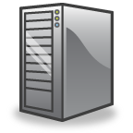

OpenFlow Switching
Controller
OpenFlow Client
PC
Software
Layer
OpenFlow Table
MAC
src
MAC
dst
IP
Src
IP
Dst
TCP
sport
TCP
dport
Action
Hardware
Layer
*
*
*
5.6.7.8
*
*
port 1
port 1
port 2
port 3
port 4
5.6.7.8
1.2.3.4
22
The Stanford Clean Slate Program, http://cleanslate.stanford.edu

Slide 23
OpenFlow Table Entry
Rule
Action
Stats
Packet + byte counters
Forward packet to port(s)
Encapsulate and forward to controller
Drop packet
Send to normal processing pipeline
…
Switch
Port
MAC
src
MAC
dst
Eth
type
VLAN
ID
IP
Src
IP
Dst
IP
Prot
TCP
sport
TCP
dport
+ mask
The Stanford Clean Slate Program, http://cleanslate.stanford.edu
Notes:
The earliest prototype… just to get an idea

Slide 24
OpenFlow Examples
Switching
Switch
Port
MAC
src
MAC
dst
Eth
type
VLAN
ID
IP
Src
IP
Dst
IP
Prot
TCP
sport
TCP
dport
Action
*
*
00:1f:..
*
*
*
*
*
*
*
port6
Routing
Switch
Port
MAC
src
MAC
dst
Eth
type
VLAN
ID
IP
Src
IP
Dst
IP
Prot
TCP
sport
TCP
dport
Action
*
*
*
*
*
*
5.6.7.8
*
*
*
port6
Firewall
Switch
Port
MAC
src
MAC
dst
Eth
type
VLAN
ID
IP
Src
IP
Dst
IP
Prot
TCP
sport
TCP
dport
Action
*
*
*
*
*
*
*
*
*
22
drop
OpenFlow/SDN tutorial, Srini Seetharaman, Deutsche Telekom, Silicon Valley Innovation Center

Slide 25



OpenFlow Usage
Controller
Alice’s code:
Simple learning switch
Per Flow switching
Network access control/firewall
Static “VLANs”
Her own new routing protocol: unicast, multicast, multipath
Home network manager
Packet processor (in controller)
IPvAlice
Alice’s Rule
Alice’s code
OpenFlow Switch
PC
Decision?
OpenFlow
Protocol
Alice’s Rule
Alice’s Rule
OpenFlow Switch
OpenFlow Switch
OpenFlow/SDN tutorial, Srini Seetharaman, Deutsche Telekom, Silicon Valley Innovation Center
Notes:
Table entries can be updated

Slide 26

OpenFlow
Standard way to control flow-tables in commercial switches and routers
Just need to update firmware
Essential to the implementation of SDN

Slide 27

Centralized/Distributed Control
“Onix: A Distributed Control Platform for Large-scale Production Networks”
Centralized Control
Distributed Control
Controller
Controller
OpenFlow
Switch
OpenFlow
Switch
Controller
OpenFlow
Switch
OpenFlow
Switch
OpenFlow
Switch
OpenFlow
Switch
Notes:
Partition, aggregation, consistency, durability
Asynchronous but eventually consistent

Slide 28
Outline
What is SDN?
Limitations of current networks
The idea of Network OS
What is OpenFlow?
How it helps SDN
The current status & the future of SDN
Conclusions

Slide 29
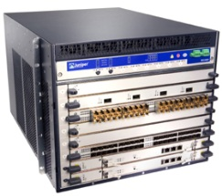
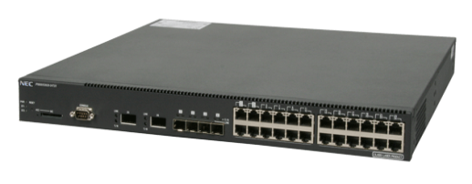
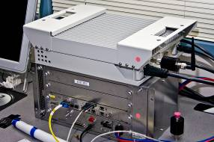
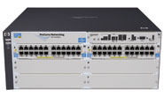
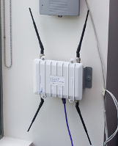

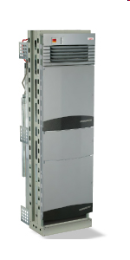

Current status of SDN
Hardware support
Juniper MX-series
NEC IP8800
WiMax (NEC)
HP Procurve 5400
Netgear 7324
PC Engines
Pronto 3240/3290
Ciena Coredirector
More coming soon...
Notes:
Not only switches but other network components

Slide 30
Current status of SDN
Industry support
Google built hardware and software based on the OpenFlow protocol
VMware purchased Nicira for $1.26 billion in 2012
IBM, HP, NEC, Cisco and Juniper also are offering SDNs that may incorporate OpenFlow, but also have other elements that are specific to that vendor and their gear.
http://gigaom.com/2012/03/19/are-vendors-closing-openflow/
http://gigaom.com/2012/12/17/2012-the-year-software-defined-networking-sold-out/
http://www.extremetech.com/internet/140459-networking-is-getting-better-and-thats-partly-thanks-to-google
Notes:
Nicira offers a way to build scale out virtualized networks and uses OpenFlow, but only as a small aspect of its controller product.
100+ institutions around the world are using openflow

Slide 31
Future Focuses of SDN
Research focuses
SIGCOMM HotSDN 2012
Mostly implementations of newly proposed systems, frameworks, or applications
SDN Concepts and Applications, Survey of SIGCOMM HotSDN 2012, Jason, Tsung-Cheng, HOU, Wanjiun Liao

Slide 32
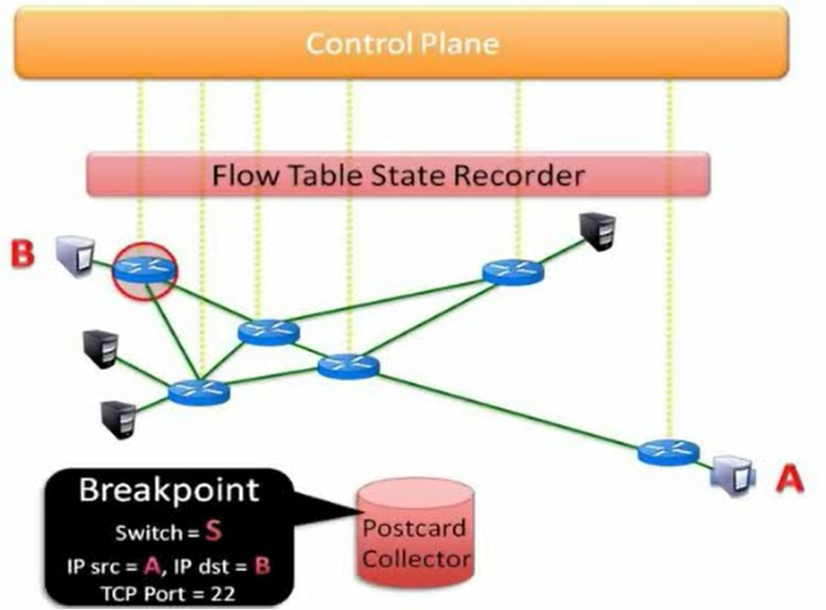
Future Focuses of SDN
New policies for security
Programmable WLANs
The placement of controllers (amount; location; centralized/distributed)
Debugger for SDN
* All references are listed in the last slide.
Notes:
Transparently changing host IP to avoid attack – sdn provides a namespace interface (a strong mapping mechanism)
2. access point (AP) association decisions are not made by the infrastructure, but by clients. Have no control to that part… state changes.. Virtual AP for management
4. Breakpoints and packet backtraces

Slide 33
Conclusions
What is SDN?
A system-layered abstraction
Programmable, flexible, and extensible
What is OpenFlow?
Interface between switches and controllers
Enabling SDN
Future SDN
Enabling innovation
Notes:
SDN not about new mechanisms; can use current
Forwarding primitives (e.g., MPLS)
State distribution primitives (e.g., flooding as in OSPF)
Operator control programs (e.g., BGP on scale-out router)

Slide 34
Thanks! songchun.fan@duke.edu

Slide 35
References
Natasha Gude et al., “NOX: Towards an Operating System for Networks”
Nick McKeown et al., “OpenFlow: Enabling Innovation in Campus Networks”
Teemu Koponen et al., “Onix: A distributed control platform for large-scale production networks”, OSDI, Oct, 2010
D Levin et. al., “Logically centralized?: state distribution trade-offs in software defined networks”, HotSDN 2012
Brandon Heller et al., “The controller placement problem”
N Handigol et. al., “Where is the debugger for my Software-Defined Network?”, HotSDN 2012
L Suresh et. al., “Towards programmable enterprise WLANS with Odin”, HotSDN 2012

